Slide 1
Strategic Asset Allocation (SAA) Model
MODEL OVERSIGHT COMMITTEE
Context, methodology, inputs and optimisation process
UK Model Risk Management (UKRM) · Model owner: Wealth & Asset Management · November 2026
Notes:
Purpose of this pack: give the Committee a common understanding of what the SAA model does and how it works, before discussing validation findings.

Slide 2
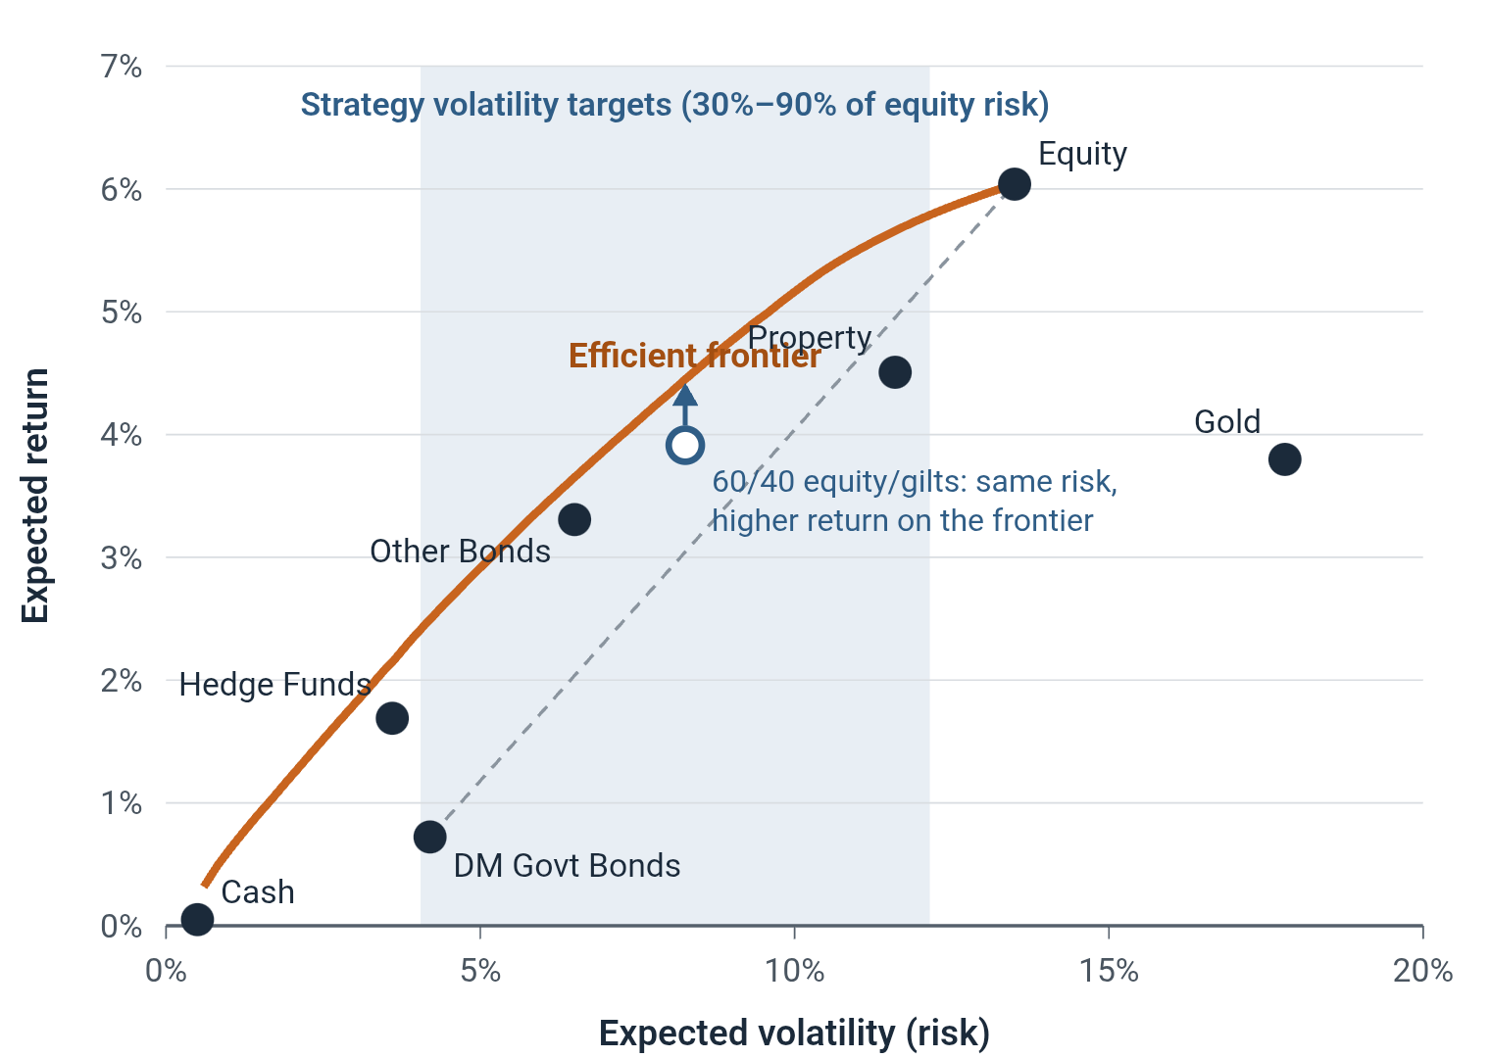
Context and methodology
Use and role
Sets the long-term asset mix of 10 customer strategies (Defensive to Growth, Income, Responsible). Risk framework, TAA benchmark and performance basis.
Diversification and mean-variance optimisation
Assets that do not move together partly offset each other, so a portfolio is less risky than the average of its parts (Markowitz, 1952).
Example: 60% equity / 40% gilts, correlation ≈ 0. Average volatility 9.8%; portfolio volatility 8.3%.
The optimiser finds the highest expected return for each level of risk: the efficient frontier. Each strategy sits on it at its own volatility target.
Key assumptions
Historic volatility and correlation predict future risk
Returns are long-term steady state; no valuation reversion
Real GDP growth proxies real earnings growth
Zero real return on cash (inflation = cash rate)
Fixed composite weights with UK ×4 home bias
Listed UK real estate proxies commercial property
Illustrative only: composite inputs at 30/11/2021; long-only frontier computed by UKRM. Dashed line: no diversification benefit.
Notes:
Diversification: portfolio volatility depends on the correlation between assets, not just their individual volatility. With equity at 13.5% and gilts at 4.2% volatility and near-zero correlation, a 60/40 mix has 8.3% volatility against a 9.8% weighted average. The dashed line shows what you would get with perfectly correlated assets; the curve above it is the benefit. Mean-variance optimisation (Markowitz) uses expected returns, volatilities and correlations to find the frontier. The shaded band shows the strategies' volatility targets, equally spaced between 30% and 90% of equity volatility. Key assumptions are the most material ones identified by UKRM; valuation reversion is left to the TAA process. The frontier is a UKRM illustration, not a model output.

Slide 3
Validation scope
9
5
19 → 7
10
8
review areas
linked workbooks traced
indices to composites
strategies covered
findings raised
Scope
Clarification notes
First independent validation of a long-standing model, newly in MRM scope this year. Model owner: Wealth & Asset Management. Standard: PRA SS1/23.
Review covers the model only; investment decisions taken on its outputs sit with other committees
@RISK treated as a vendor engine; no UKRM licence, so no re-execution of optimisation or simulation
No UKRM access to FactSet, S&P or JPMorgan data; refresh observed with the model owner
Developer documentation is out of date versus the model in use
Components covered end to end
Data and indices
Composites
Expected returns
Risk inputs
Optimisation
Simulation
Outputs
Implementation
Governance
Notes:
The model has been in use for several years without a prior independent validation. The review was carried out collaboratively with Wealth and Asset Management. The five linked workbooks are Composite Weights, Forward Looking Return Assumptions, SAA Input Data, SAA Model and SAA Output. Where UKRM could not re-execute components, evidence comes from static review of files and VBA and from observation with the model owner.

Slide 4
Independent validation activities
1
Documentation
2
Data and indices
3
Composite construction
Reconciled docs to model files
Walked through run instructions
Logged gaps, e.g. 21 vs 19 indices
Observed FactSet refresh
Reviewed index choice and hedging
Assessed data-quality controls
Traced weight calculations
Challenged UK ×4 and equal weights
Assessed corner-solution rationale
4
Expected returns
5
Risk inputs
6
Optimisation
Traced building blocks to source
Reviewed HVA regression and blend
Challenged BBA assumptions
Traced volatility formulae
Traced correlation and yield
Checked data window and medians
Reviewed objective and constraints
Static review of VBA macros
Reviewed penalty functions
7
Simulation and outputs
8
Assumptions and benchmarking
9
Governance and controls
Reviewed vendor simulation method
Reviewed horizon and start value
Reviewed output metrics
Built UKRM assumptions register
Separated judgement from data
Benchmarked vs alternative methods
Assessed roles and monitoring
Mapped all manual copy-paste steps
Assessed documentation vs SS1/23
Evidence: developer documentation, all five workbooks and VBA, owner walk-throughs, and published research (Markowitz; Black-Litterman; risk parity).
Notes:
This slide shows the breadth and depth of UKRM's review. Every component of the model was examined, from data sourcing to outputs and governance. Highlights: each building block of the expected-return method was traced to its source; volatility and correlation formulae were traced in the workbooks; the optimiser set-up (objective cell, decision variables, penalty functions, iteration passes) was reviewed from the files and VBA; every manual copy-paste step between workbooks was mapped; and UKRM built its own register of key assumptions and expert judgement. These activities support the 8 findings raised.

Slide 5

Inputs and processing
How market data become the numbers the optimiser uses
1
Collect data
2
Estimate each index
3
Group into 7 classes
4
Feed the optimiser
19 indices plus economic data, sourced through FactSet
Expected return, risk and yield for each index
Fixed weights combine indices into 7 asset classes
Return, risk, yield per class, plus correlations
Why 7 asset classes, not 19 indices?
Optimiser inputs (step 4)
Key data treatments
Class | Return | Risk | Yield
Equity | 6.04% | 13.5% | 2.04%
DM govt bonds | 0.72% | 4.2% | 0.61%
Other bonds | 3.31% | 6.5% | 3.82%
Property | 4.51% | 11.6% | 2.60%
Gold | 3.80% | 17.8% | 0.00%
Hedge funds | 1.69% | 3.6% | 0.00%
Cash | 0.05% | 0.5% | 0.05%
15.9 years of monthly data
Non-equity indices GBP-hedged
Medians smooth out outliers
Returns: 50/50 BBA and HVA
Listed REITs proxy property
Inflation set equal to cash
Some indices move together (UK vs US equity correlation ≈ 0.8) but had very different past returns
The optimiser over-reacts to small return differences: all in one index, nothing in another (“corner solutions”)
Grouping keeps allocations diversified and stable despite uncertain return estimates
+ correlation matrix → next slide
Implementation: Excel workbooks, refreshed annually from FactSet. Values shown at 30/11/2021.
Notes:
Plain-language walk-through. Step 1: about 19 market indices covering equities, bonds, property, gold, hedge funds and cash, with economic data, all sourced through FactSet. Step 2: for each index, expected return blends a Building Block estimate (risk-free rate plus income plus real growth) with a risk-based regression (HVA), 50/50; volatility and correlation come from historic monthly data; yield is a 12-month median. Step 3: indices are combined into 7 composites with fixed weights, rebalanced annually: equities and government bonds by market size with UK at four times its weight; other bonds and hedge funds equally weighted. Why: closely correlated indices with slightly different return forecasts push the optimiser to extremes (corner solutions); grouping avoids allocations driven by estimation error. Step 4: composite return, risk, yield and correlations go to RISKOptimizer on the next slide. Values shown are from the 30/11/2021 developer documentation.

Slide 6
Optimisation, simulation and outputs
1 · Optimise (@RISK RISKOptimizer)
2 · Simulate
3 · Materiality check
Maximise mean simulated portfolio value at year 20
7 composite weights, 0.1% steps
Soft constraints: volatility target, min/max per composite, min yield for Income
Two passes; core strategies first
Monte Carlo, 10,000 paths over 20 years per strategy
Rank-order correlated composite returns
Historic back-test on 20 years of index data
Change vs prior-year SAA: sum of weight changes and tracking error
Immaterial changes revert to prior-year mix and are re-simulated
Outputs for each of the 10 strategies
Weights by composite and unbundled to index level
Historic: return, excess over cash and inflation, volatility, max drawdown, recovery, yield
Projected: mean, 10th and 90th percentile returns, volatility, drawdown, yield
UKRM has no access to @RISK: assessment of this stage rests on static review of the workbooks and VBA, not re-execution.
Notes:
Decision variables are composite weights in cells C48:C54, integers 0–1,000. Volatility targets are equally spaced between 30% and 90% of equity volatility. Penalty functions: (1000 x deviation)^2 for volatility and minimum yield; (100 x deviation)^2 for other constraints. First pass 500 iterations, second 1,000 to confirm a global maximum. Income and Responsible strategies are optimised after the core strategies because their yield and hedge-fund constraints feed off the core output. Vendor describes the simulation as distribution-free, using Spearman rank correlation. Materiality threshold is currently the ex-ante standard deviation and should be evaluated each year.

Slide 7
Strengths and weaknesses
Strengths
Weaknesses and areas of challenge
Established methodology. Markowitz MVO is transparent and widely understood.
Governance. No formal monitoring plan; roles unclear; documentation below SS1/23 minimum.
Composites. Limit estimation error and avoid corner solutions.
Implementation. Linked workbooks with manual copy-paste; reliant on FactSet and @RISK.
Fundamental returns. Building blocks grounded in published research; medians dampen outliers.
Data quality. No first-line data checks; some vendor data cannot be verified.
Stability by design. Annual refresh, 1-year median rates and a materiality check limit turnover.
Expected returns. BBA rests on simplifying assumptions; HVA is not independent of BBA.
Rich outputs. Back-test plus Monte Carlo metrics, consistent across 10 strategies.
Proxies and history. Listed property proxy; historic risk may miss regime shifts.
Remediation planned in two phases: governance and controls first, then BBA, HVA and the Property proxy.
Notes:
The five governance and control weaknesses are grouped as one theme for short-term remediation before the review anniversary. Methodology points (BBA, HVA, Property proxy) form a second phase. HVA regresses BBA outputs on historic volatility, so the blend dampens rather than independently checks BBA. Historic correlation estimates may not capture shifts such as the change in equity-bond correlation.

Slide 8
Where should we challenge the model?
FOR DISCUSSION · OPTION A
Four open questions on assumptions and design, then one stress test
1
Expected returns
2
Historic risk and correlation
3
Fixed design judgements
4
Reliance on the toolset
Model assumes: Long-term “steady state” returns; zero real return on cash
Model assumes: 15.9 years of history predict future volatility and co-movement
Model assumes: UK ×4 home bias; listed real estate stands in for property
Model assumes: Manual Excel steps; vendor optimiser not independently re-run
How much should we trust the return forecasts that drive the allocation?
Is the past a reliable guide when markets change regime?
Do these judgements still reflect how we invest and what clients hold?
How much reliance can we place on outputs we cannot reproduce?
Stress scenario: inflation and rate shock. Rates rise sharply; equities and bonds fall together; cash loses real value.
Would the strategies still meet their risk targets?
Would the model outputs remain valid, or need an off-cycle review?
What signals should tell us to act?
Notes:
Format: question cards. Each card states what the model assumes and poses an open question; do not offer answers. Invite the Committee to discuss each card, then move to the stress panel and ask how these assumptions would behave in that scenario. The model inputs assume near-zero correlation between equities and developed-market government bonds and an inflation rate equal to cash. To reuse for another model: keep the structure and replace the challenge areas (assumption or design, what the model assumes, open question) and the stress scenario. Do not answer the questions on the slide; the aim is open discussion.

Slide 9
Assumptions under stress
FOR DISCUSSION · OPTION B
Which assumptions hold, bend or break in each scenario?
Assumption or design area | Inflation and rate shockEquities and bonds fall together | Prolonged UK underperformanceUK lags global markets for years | Property liquidity stressDirect property funds suspend dealing
Expected returns | Does a zero real cash rate still make sense? | Do 20-year medians react too slowly? | Are listed property returns a fair guide?
Historic risk and correlation | If bonds stop hedging equities, is risk understated? | Does 15.9 years capture this regime? | Is listed real estate volatility representative?
Fixed design judgements | – | Is a UK ×4 home bias still justified? | Does the listed proxy hide liquidity risk?
Reliance on the toolset | Could we re-run the model quickly mid-year? | – | Who decides on an off-cycle review?
In which scenario would the model outputs no longer be valid, and how would we know?
Notes:
Format: assumption-by-scenario matrix. Rows are the four challenge areas, columns are three stress scenarios. Shaded cells carry an open question; dashes mark combinations with little direct link, which the Committee can still challenge. Walk the matrix by column, asking whether each assumption holds, bends or breaks. Close with the question at the bottom. To reuse for another model: keep the structure and replace the challenge areas (assumption or design, what the model assumes, open question) and the stress scenario. Do not answer the questions on the slide; the aim is open discussion.

Slide 10
What if 2022 happens again?
FOR DISCUSSION · OPTION C
One stress scenario, the assumptions it tests, and the questions it raises
ASSUMPTIONS UNDER PRESSURE
STRESS SCENARIO
?
Expected returns
Inflation and rate shock
Long-term “steady state” returns; zero real return on cash
Inflation runs well above cash rates
Interest rates rise quickly
Equities and government bonds fall together
Investors seek liquidity; property funds may gate
?
Historic risk and correlation
15.9 years of history predict future volatility and co-movement
?
Fixed design judgements
UK ×4 home bias; listed real estate stands in for property
?
Reliance on the toolset
Manual Excel steps; vendor optimiser not independently re-run
Would outputs still be valid?
Would strategies breach risk targets?
What should trigger an off-cycle review?
Notes:
Format: single scenario narrative. Describe the scenario in plain terms, then go through each assumption under pressure without answering. Useful prompts: the model sets expected inflation equal to cash; equities and government bonds have near-zero correlation in the inputs; property is proxied by listed real estate. Close with the three questions at the bottom. To reuse for another model: keep the structure and replace the challenge areas (assumption or design, what the model assumes, open question) and the stress scenario. Do not answer the questions on the slide; the aim is open discussion.

